Slide 1

UCAELI Conversation Partner Orientation
A crash course in how to be a great Conversation Partner!

Slide 2
Part One:
Welcome to UCAELI!

Slide 3
General Information about UCAELI
UCAELI students are international students enrolled in full-time English language courses at UConn.
Many of these students are preparing to enter a college or university in the U.S. Others are improving their English skills for professional purposes or simply to be able to communicate better.
This program is offered year-round in four sessions. Students in the program study English 22 hours per week from Monday through Friday.
Students’ proficiency levels: beginner to advanced.
  Instructors will inform Conversation Partners about their students’ level.

Slide 4
Who are Conversation Partners?
Conversation Partners are people of all ages who are interested in meeting people from different cultures.
Previous volunteers have included university students and staff, local middle school and high school students, and other members of the community.
Informal conversation with fluent English speakers is an important aspect of learning the language. Students need to hear English and practice with their peers in personal and informal settings. Many of our previous students and Conversation Partners have formed lasting friendships!
Volunteering to be a Conversation Partner is a way to experience another culture without ever leaving the Storrs campus. Who knows, you may end up visiting our students in their countries someday!

Slide 5
What happens during a
Conversation Partner Class?
The activities during conversation time are linked to UCAELI Communication Skills course objectives.
Generally, partners will be placed with a small group of UCAELI students who will have some questions or conversation strategy to practice relating to something they are learning in their classes.
Topics and activities vary from discussions about culture, current events, academic subjects, and university life.

Slide 6
Instructors are a resource for you!
The instructors:
  facilitate the activity
  circulate the classroom listening and joining into conversation when they see fit
  should be consulted when there is any question about the conversation partner’s role or activity objective
  should be approached when a conversation partner is uncomfortable with a question or topic
  are open to conversation partner feedback

Slide 7
Conversation Partner Tip for the first class:
Have an open mind
Be aware of the level of English proficiency of the students in the class
Take a look at the EAQUALs Descriptors for Listening and Spoken Interaction to have a better understanding of what students need to be able to do at each level.
Be ready to share, listen, learn, collaborate and converse!

Slide 8
Part Two:
Be open to and respect other cultures!

Slide 9
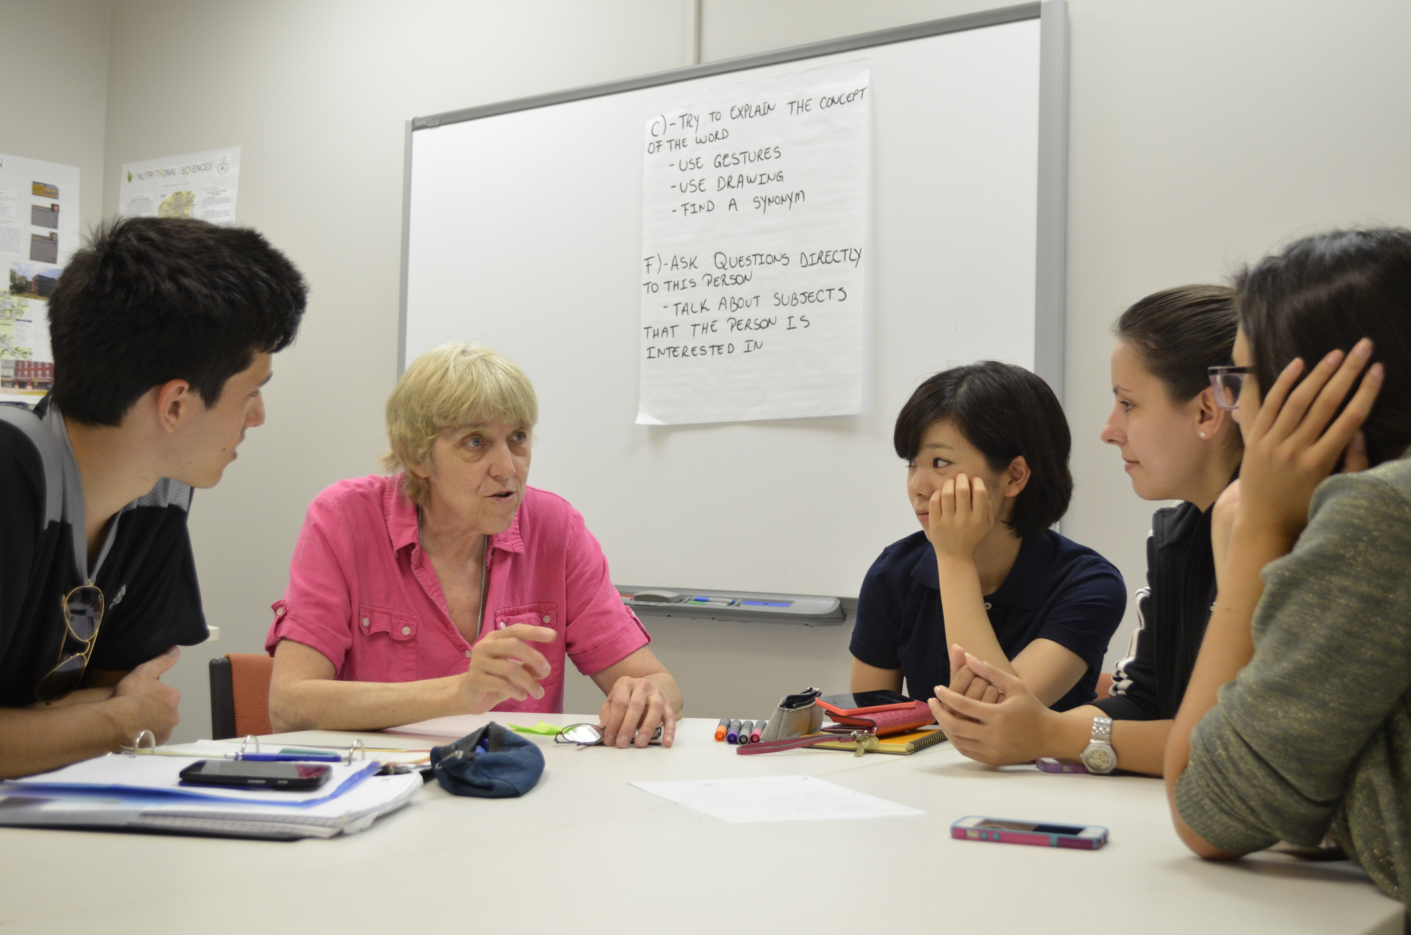
Our goal is to create a comfortable learning environment for all of our students.

Slide 10
Note: Some students will…
Not have a lot of experience conversing with people of the opposite gender.
Be uncomfortable discussing certain topics.
Be really shy to speak the first few weeks.
Remember: patience, sensitivity and respect is key!

Slide 11

Be careful not to criticize a student’s culture or religion

Slide 12
Conversation Partner Tip:
Ask about the student’s home country, family and traditions!
Questions about these topics allow students to share their own culture.
Contribute when you see fit.
Find commonalities through these topics to make connections!

Slide 13
Part Three:
Understanding each other’s speech

Slide 14
You will probably need to speak more slowly and clearly than usual, especially with lower-level students.
Take your time and make sure the student understands.

Slide 15

If a student does not understand what you said, try to restate it in a different, simpler way.

Slide 16
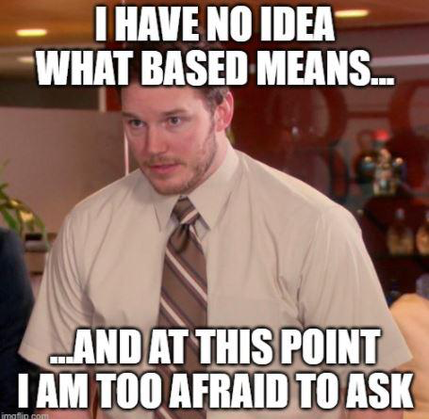
Commonly, students will smile and nod their head appearing to understand what you are saying while they really have no idea.

Slide 17
Conversation Partner Tip:
Promote Active Listening to combat the
“Head Nodding Effect”
Pause often and elicit a verbal response
Check in for understanding
  Don’t ask: “Do you understand?”
  Ask a question related to what you are saying
  For example:
    You’re chatting about your pet at home and instead of asking if they understood that you were talking about your beloved cat, ask them if they have any pets of their own!
Avoid “yes” / “no” questions!

Slide 18
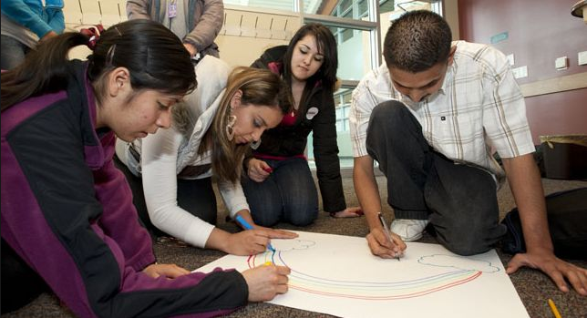
Conversation Partner Tip:
Drawing pictures helps low level beginners.

Slide 19
Sometimes student’s do not understand “American Slang”
Try to limit the use of words or phrases like:
“hanging out”
“that’s cray”
“epic fail”
“I got cold feet”
“feeling under the weather!”
“awesome”
“dude”
“It was a blast”
“The food is bomb”
“He is ripped!”
“That’s dope”
“just chillin’”
“bro”
“That was sick”
“Spill the tea or spill the beans”

Slide 20
Conversation Partner Tip:
If you use “American Slang,” explain it!
“awesome” = great, really good, etc.

Slide 21

Be aware of potential cultural blind spots
Explain it. They probably want to know!
Make sure the students know what you’re talking about.
Believe it or not, not everyone knows about Beyonce!

Slide 22

Conversation Partner Tip:
Encourage student speaking
Try not to go on long rants or stories without checking in
Do not be the only participant in the conversation – share air-time!
Students should talk AT LEAST as much as you do, if not MORE ☺

Slide 23
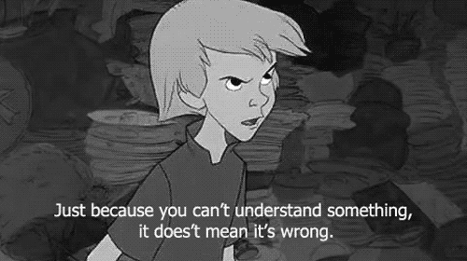
Don’t be afraid to tell students that you don’t understand what they are saying!
Just kindly ask them to repeat it or use different words to explain!

Slide 24

You can correct a student’s pronunciation.
Do it nicely and make sure you let them know once they say it
correctly!

Slide 25
In sum, when you’re in a low-level class:
Talk slower than you normally would
Ask questions to check for understanding
Draw!
Don’t be afraid to help with pronunciation
Use simple vocabulary
Avoid culturally-bound language: idioms or references to specific to American life
    For example: government policies, tax systems, etc.

Slide 26

Part Four:
Group Work

Slide 27

Conversation Class Objectives
One of the priorities of the Conversation Partner Program is to enhance topics and skills from their UCAELI class
  Incorporate these topics and skills into conversation if you can
  If you are unsure of the current focus of the class, feel free to ask the instructor

Slide 28
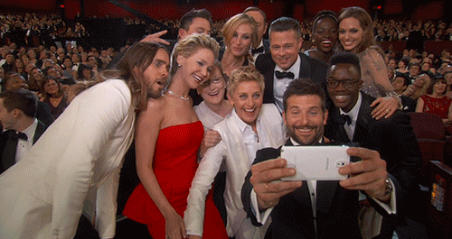
Try to make sure everyone in your group contributes to conversation.

Slide 29
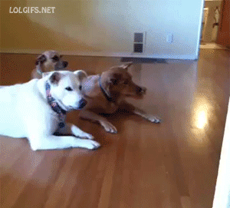
Sometimes outgoing students will dominate the conversation.

Slide 30

Try to make an effort to draw out quiet, shy or lower-level students.

Slide 31

Also, make sure you’re not the one talking too much!
Ask questions!
Facilitate the conversation, but don’t overpower it!

Slide 32
Part Five:
The students appreciate you!

Slide 33

Our students consistently report the positive impact of the Conversation Partner interaction
They learn a lot from conversing with you each week!

Slide 34

Conversation Partner Tip: Have fun!!
Celebrate cross-cultural experience with UCAELI!

